Slide 1
Agentic AI Hackathon: AI-Based Climate Risk Assessment for Agriculture

Slide 2



Name of the team: TECHHOPE
Details of Team members
TEAM MEMBER NAME | Recent Passport Photo | Email ID | Phone number [WhatsApp]
Shreyas R V |  | rvshreyas131@gmail.com | 8088320572
SHASHANK URS H P |  | shashankaras24@gmail.com | 7892403016
Yogeshwaran G |  | yw891@gmail.com | 8217051721

Slide 3
Problem statement
Problem Statement: AI-Based Climate Risk Assessment for Agriculture
Climate variability significantly affects agricultural productivity
Extreme weather events, shifting seasons, and unpredictable rainfall increase farming risks
Farmers and agricultural planners lack tools to interpret climate data in an actionable manner
Existing solutions are often generic and not localized
There is a need for an intelligent assistive system to analyze climate trends and assess agricultural risk at a local level

Slide 4
Proposed solution
We propose an AI-Based Climate Risk Assessment System using an Agentic AI architecture deployed fully on IBM Cloud.
The system:
Collects climate and historical agricultural data
Uses AI agents to analyze climate risks
Generates crop- and region-specific risk assessments
Provides actionable advisory insights in natural language
This enables farmers and stakeholders to take preventive and informed decisions.

Slide 5
Need of project
Climate change has increased the frequency of droughts, floods, and heat stress in agriculture
Farmers face difficulty in interpreting complex climate and weather data
Lack of localized and timely climate risk assessment tools for farmers
Existing agricultural advisories are often generic and not data-driven
Need for an intelligent, assistive system to convert climate data into actionable insights
Supports informed decision-making and improves climate resilience in agriculture

Slide 6
End user of project
Farmers
To understand climate risks and plan farming activities accordingly.
Agricultural Extension Officers
To provide data-driven, localized advisories to farmers.
Agricultural Planners & Policy Makers
To support climate-resilient agricultural planning and decision-making.
Local Government Bodies
To monitor regional climate risks and support preparedness initiatives.
Research Institutions
To analyze climate trends and agricultural risk patterns.

Slide 7
Technology Used
LangFlow
Used to design and orchestrate the multi-agent AI workflow.
IBM Granite Language Model (watsonx.ai)
Core AI model for climate analysis, risk detection, and advisory generation.
Retrieval-Augmented Generation (RAG)
Used to retrieve climate-smart agriculture guidelines and policy documents for reliable recommendations.
Vector Database
Stores embedded agricultural and climate documents for efficient retrieval.
Prompt Templates
Structured prompts used to guide each agent’s role and output format.
Agent-Based Architecture
Separate agents for data analysis, risk detection, and advisory planning.

Slide 8
Novelty and Uniqueness
Multi-Agent AI Architecture
Clear separation of climate analysis, risk detection, and advisory planning agents.
Risk-First Approach
Climate risks are identified and quantified before generating recommendations.
RAG-Driven Trusted Advisory
Uses climate-smart agriculture guidelines and policy documents to avoid hallucinations.
Localized Climate Risk Assessment
Generates insights based on specific location, crop, and season.
Farmer-Friendly Assistive Design
Outputs are simple, non-prescriptive, and easy for farmers to understand.

Slide 9
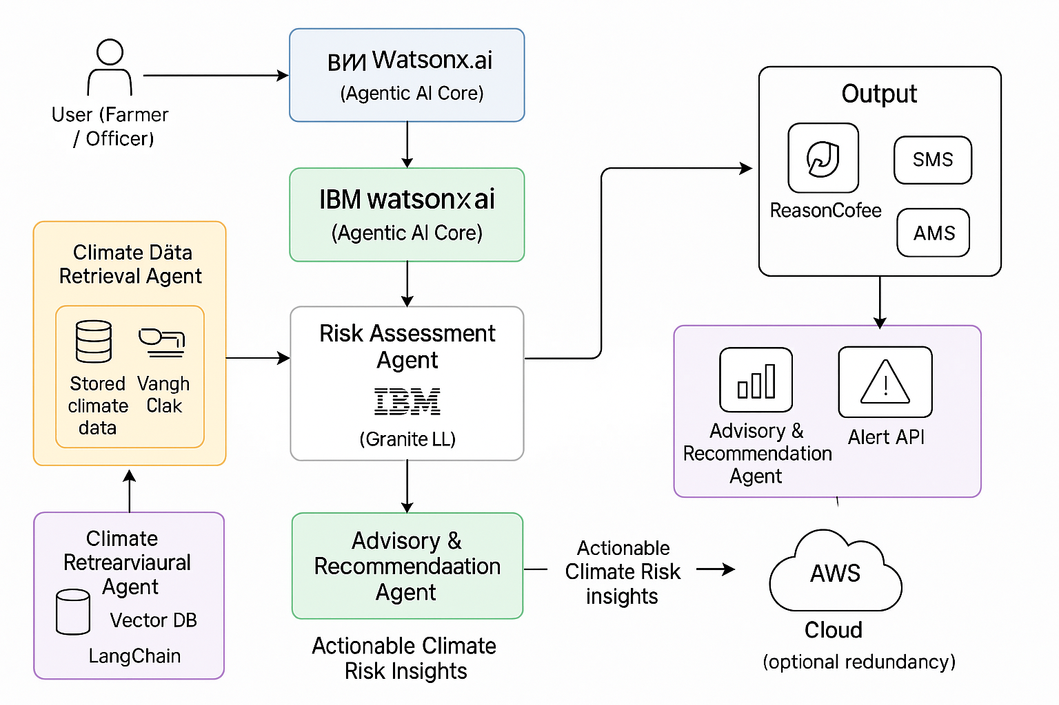
Technical flow diagram - Architecture blueprint

Slide 10
Langflow component Used
Chat Input Component
Collects user inputs such as location, crop, season, and climate details.
Prompt Template Component
Structures prompts for each agent to ensure consistent and meaningful outputs.
Climate & Crop Data Analysis Agent
Analyzes climate trends and crop-related information.
Climate Risk Detection Agent
Identifies and evaluates drought, flood, and heat stress risks.
Advisory & Planning Assistant Agent
Generates farmer-friendly advisory and planning insights.
IBM Granite Language Model (watsonx.ai)
Used as the core language model for all agents.
Vector Store & Retriever (RAG)
Retrieves relevant agricultural guidelines and policy documents.
Chat Output Component
Displays the final advisory output to the user.

Slide 11
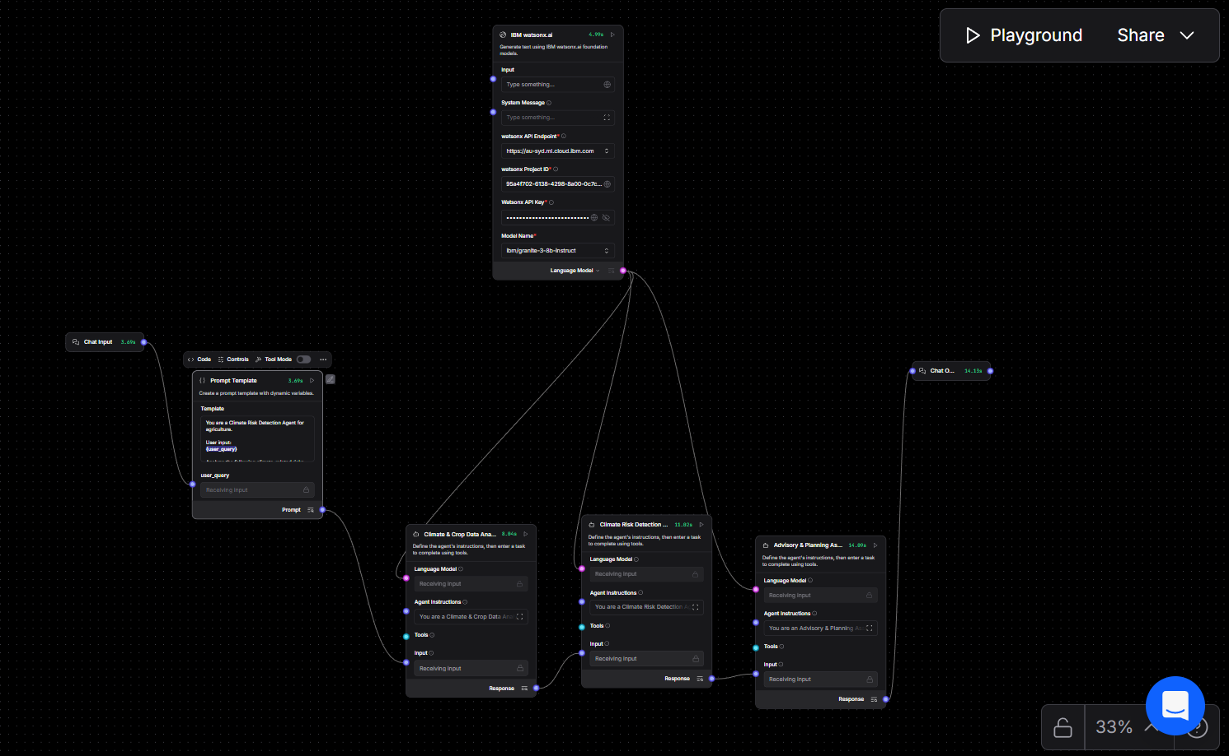
Input Screenshot 1

Slide 12
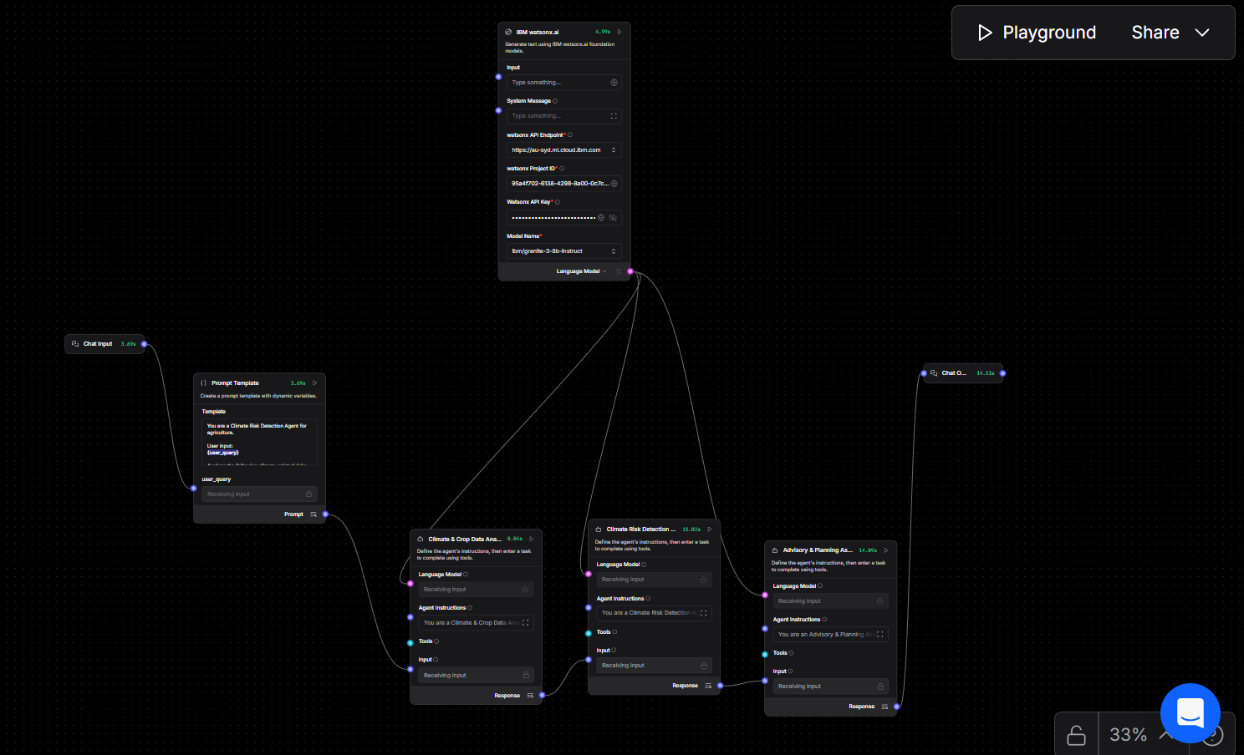
Input Screenshot 2

Slide 13
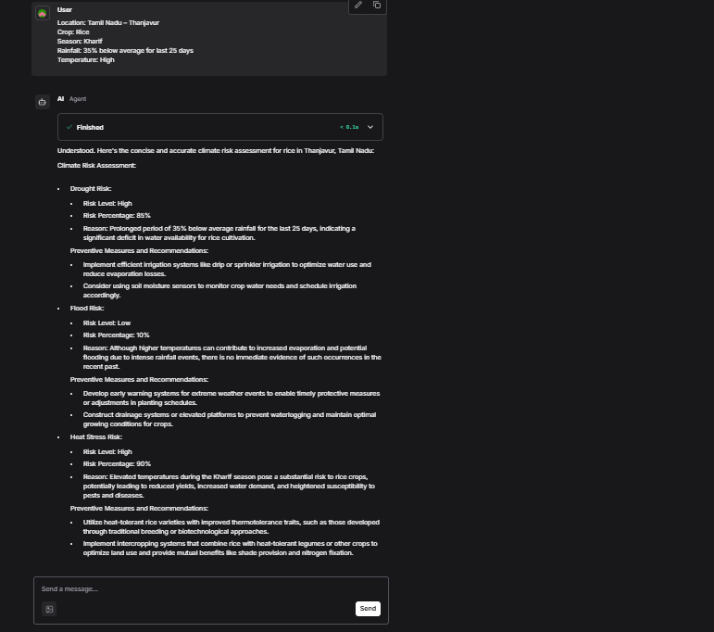
Output Screenshot 1

Slide 14
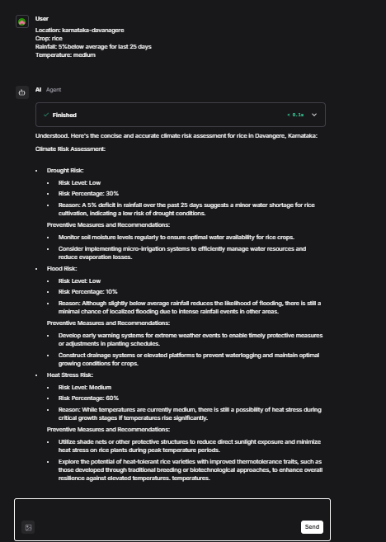
output Screenshot 2

Slide 15
Future Scope
Real-Time Climate Data Integration
Integrate live weather APIs (rainfall, temperature, humidity) for real-time risk assessment.
Crop-Specific & Region-Specific Models
Extend support to multiple crops and agro-climatic zones with customized risk thresholds.
Early Warning & Alert System
Enable SMS / mobile notifications for high-risk climate events.
Advanced Predictive Analytics
Incorporate long-term climate forecasting and seasonal prediction models.
Farmer Feedback Loop
Collect farmer inputs to continuously improve advisory accuracy.

Slide 16
Git Hub Link
· Please create public github repository (Enable Add README button while creating repository) with format –
Please test and Paste the working Github URL – https://github.com/yogeshwaran59/-climate-risk-assessment--for-agriculture.git
Make sure you have Uploaded following three files into your github repository
1) app.py file , 2) your_hackthon_problemstatement.pdf file 3) your projectpresntation.pptx file
·
·
·

Slide 17
References
FAO – Climate-Smart Agriculture Sourcebook
Food and Agriculture Organization of the United Nations
https://www.fao.org/climate-smart-agriculture
FAO – Managing Climate Risks in Agriculture
FAO Climate Risk Management Guidelines
https://www.fao.org/climate-change/resources
Government of India – Ministry of Agriculture & Farmers Welfare
Agricultural advisories and policy documents
https://agricoop.nic.in
Indian Meteorological Department (IMD)
Climate data, seasonal forecasts, and rainfall reports
https://mausam.imd.gov.in
IBM Granite Models Documentation
IBM watsonx.ai – Granite Foundation Models
https://www.ibm.com/watsonx
LangFlow Documentation
Agent-based orchestration and RAG workflows
https://docs.langflow.org

Slide 18


